Slide 1
Design Patterns
Anup

Slide 2
Creational Patterns
Abstract Factory
Creates an instance of several families of classes
Builder
Separates object construction from its representation
Factory Method
Creates an instance of several derived classes
Prototype
A fully initialized instance to be copied or cloned
Singleton
A class of which only a single instance can exist

Slide 3
Structural Patterns
Adapter
Match interfaces of different classes
Bridge
Separates an object’s interface from its implementation
Composite
A tree structure of simple and composite objects
Decorator
Add responsibilities to objects dynamically
Facade
A single class that represents an entire subsystem
Flyweight
A fine-grained instance used for efficient sharing
Proxy
An object representing another object

Slide 4
Behavioral Patterns
Chain of Responsibilites
A way of passing a request between a chain of objects
Command
Encapsulate a command request as an object
Interpreter
A way to include language elements in a program
Iterator
Sequentially access the elements of a collection
Mediator
Defines simplified communication between classes
Memento
Capture and restore an object's internal state
Observer
A way of notifying change to a number of classes
State
Alter an object's behavior when its state changes
Strategy
Encapsulates an algorithm inside a class
Template Method
Defer the exact steps of an algorithm to a subclass
Visitor
Defines a new operation to a class without change

Slide 5
Creational Patterns
Pattern | Usage
Abstract Factory | High
Builder | High
Factory | High
Singleton | High
Prototype | Medium

Slide 6
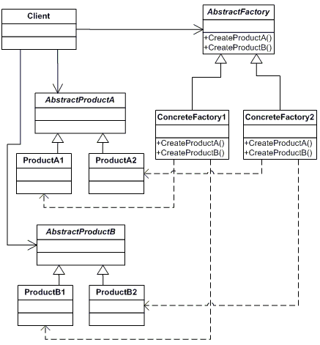
AbstractFactory

Slide 7
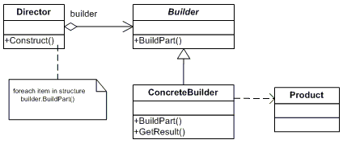
Builder

Slide 8
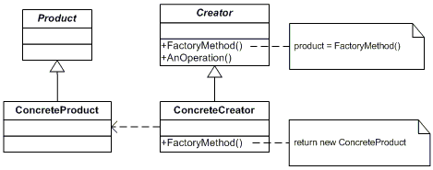
Factory

Slide 9
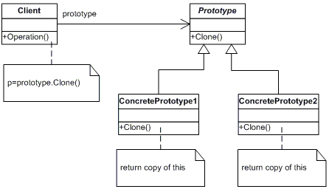
Prototype

Slide 10

Singleton

Slide 11
Structural Patterns
Pattern | Usage
Adapter | High
Bridge | Medium
Composite | High
Decorater | Medium
Flyweight | Low
Facade | High
Proxy | High

Slide 12
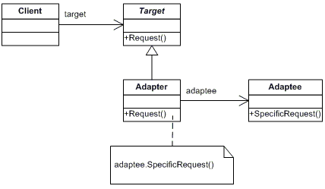
Adapter

Slide 13
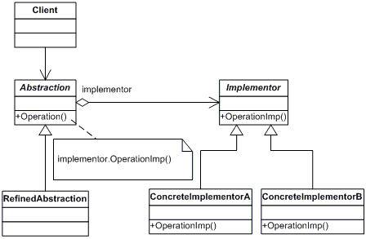
Bridge

Slide 14
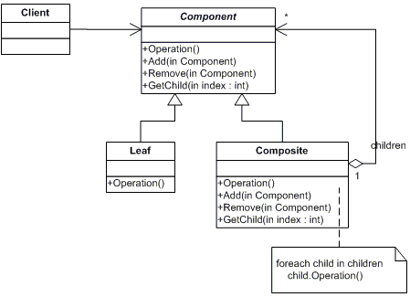
Composite

Slide 15
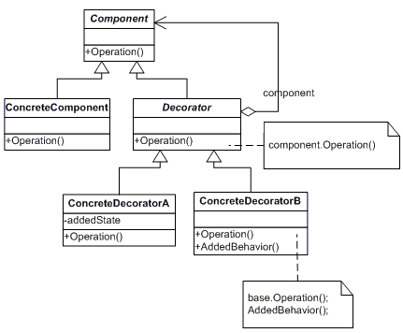
Decorator

Slide 16
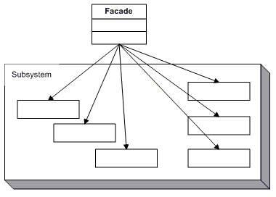
Facade

Slide 17
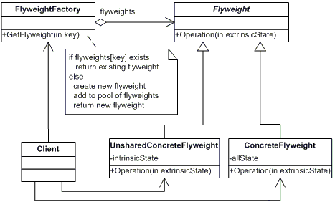
Flyweight

Slide 18
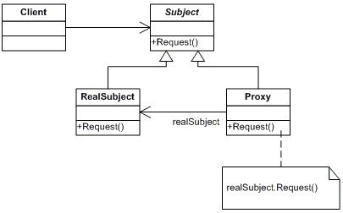
Proxy

Slide 19
Behavioural
Pattern | Usage
Chain of Responsibilities | Low
Command | high
Interpreter | Low
Iterator | High
Mediator | Low
Memento | Low
Observer | High
State | Medium
Strategy | High
Template | Medium
Visitor | Low

Slide 20
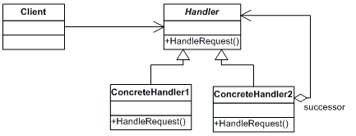
Chain of Responsibilities

Slide 21
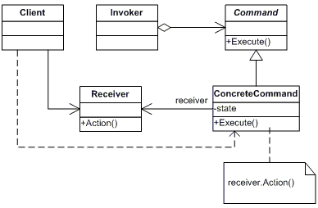
Command

Slide 22
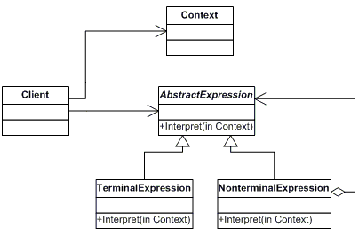
Interpreter

Slide 23
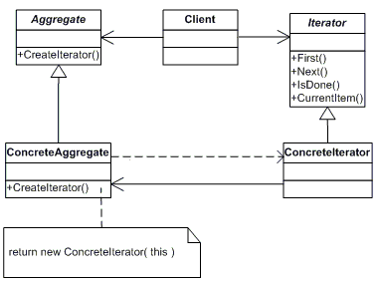
Iterator

Slide 24
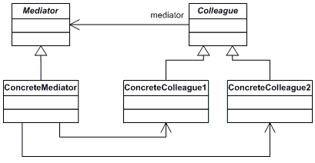
Mediator

Slide 25
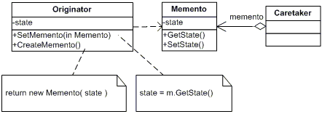
Memento

Slide 26
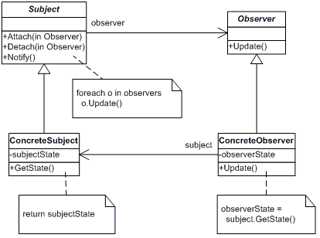
Observer

Slide 27
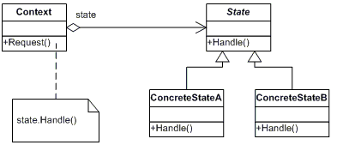
State

Slide 28
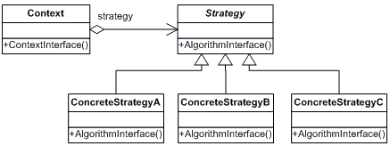
Strategy

Slide 29
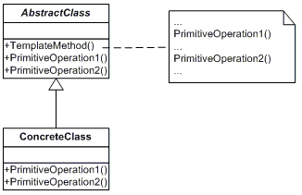
Template

Slide 30
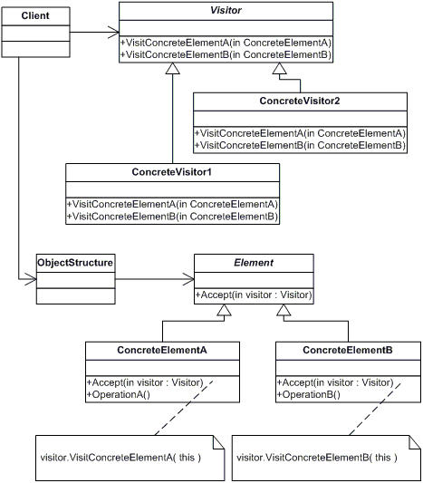
Visitior

